Slide 1

From LIBOR's Legacy to Risk-Free Rates
An Analysis of Global Interest Rate Benchmarks
by Pearlyn Rodrigues

Slide 2
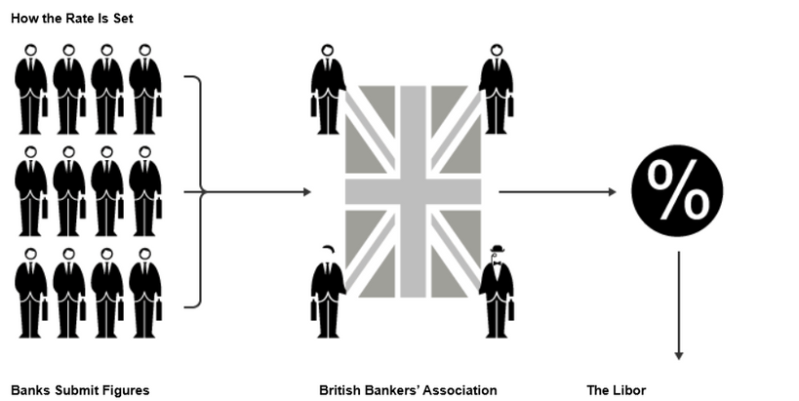
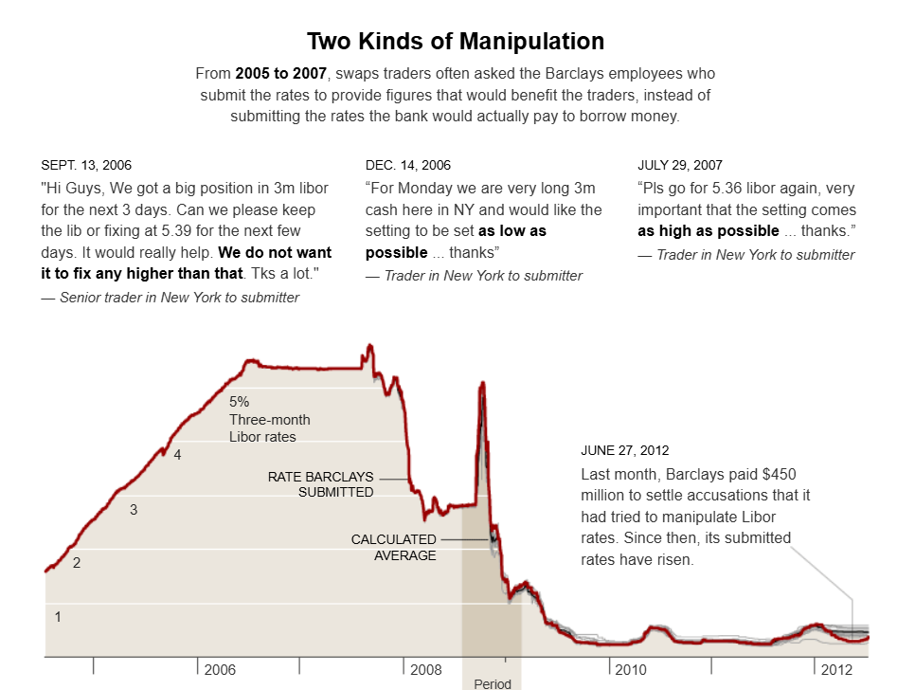
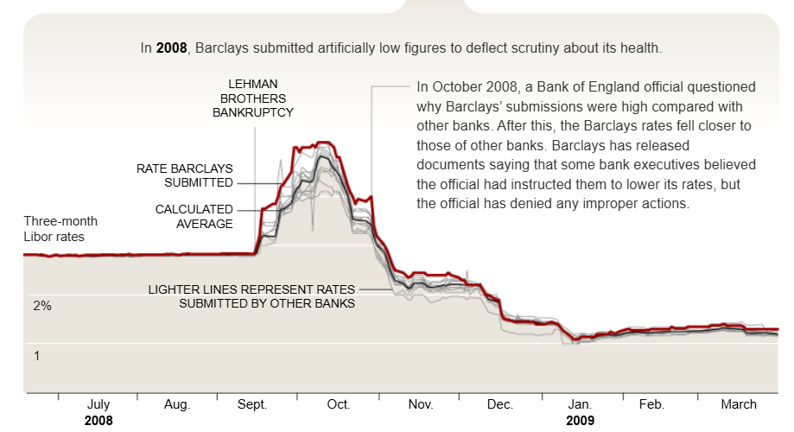
LIBOR
Source: https://archive.nytimes.com/www.nytimes.com/interactive/2012/07/10/business/dealbook/behind-the-libor-scandal.html?module=inline

Slide 3
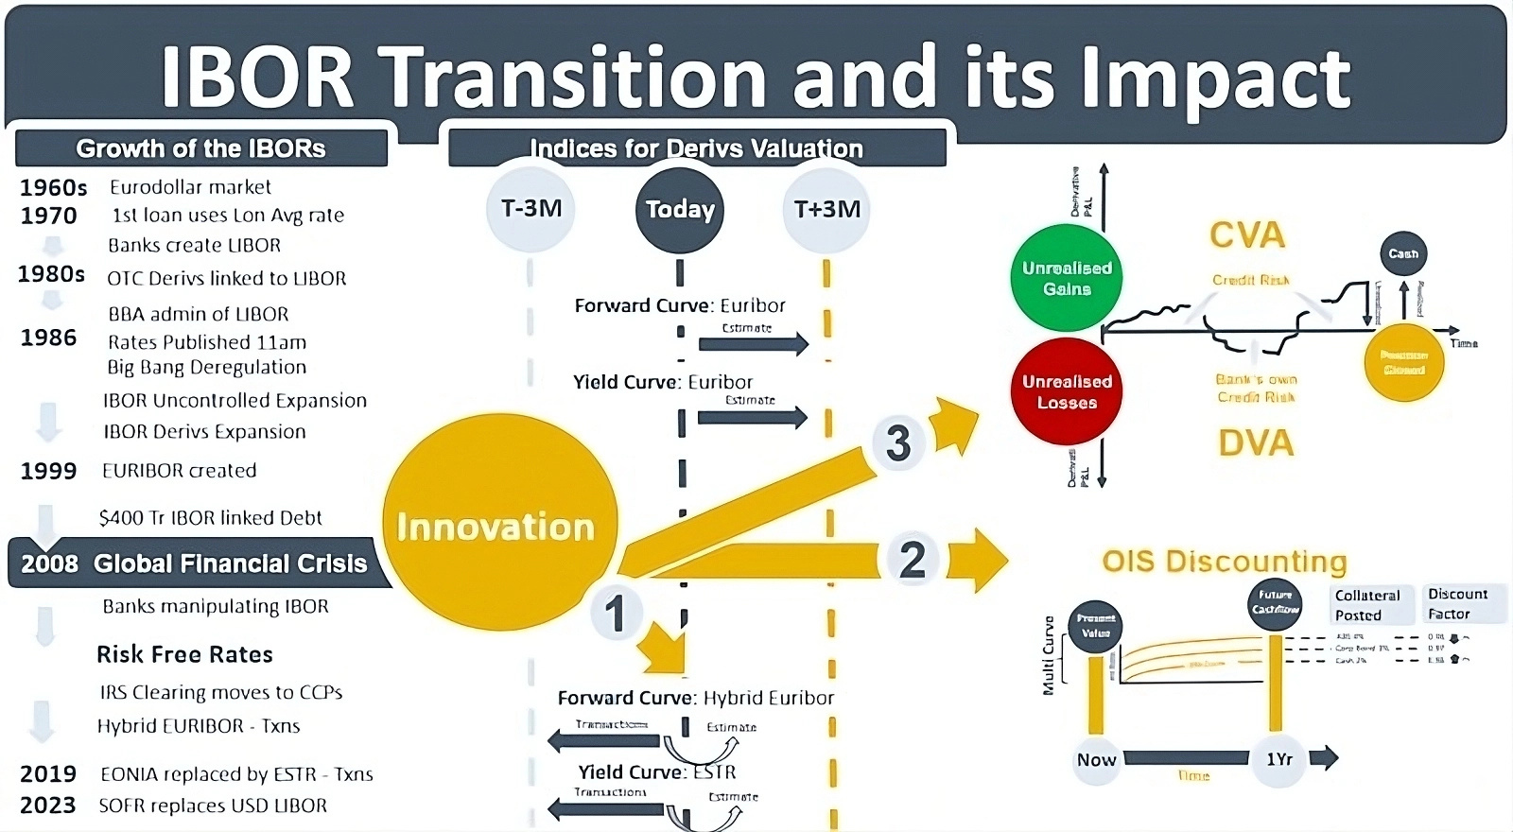
Why RFRs?
Replaced IBOR’s forward-looking estimates with overnight, transaction-based rates.
Carry only one day’s credit risk — considered virtually risk-free.
Rates derived via daily compounding from historical overnight data.
Source :https://www.thegoldensource.com/ibor-transition-and-its-impact/

Slide 4
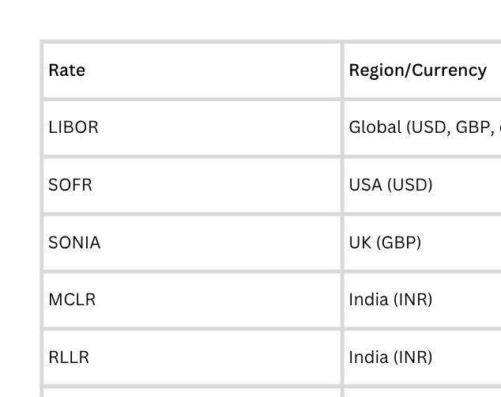
Popular Interest rates

Slide 5
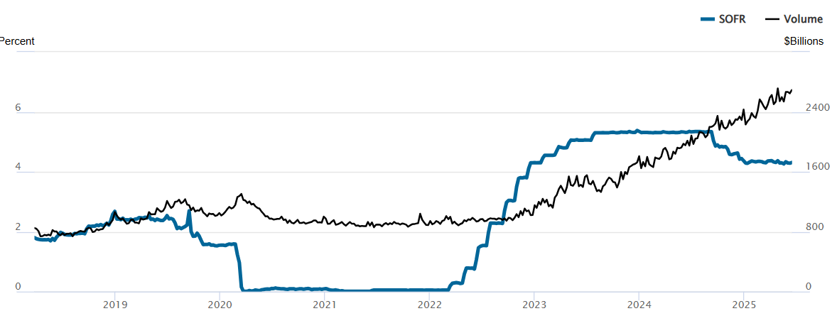
SOFR - The USD Risk-Free Rate
Secured Overnight Financing Rate (SOFR)
Definition & Region: USD risk-free rate based on overnight Treasury repo transactions
Publisher: Federal Reserve Bank of New York
Methodology: Secured, backward-looking, transaction-based
Tenor Availability: Overnight (primary), with 30, 90, 180-day term rates
Underlying Market: ~$1.7 trillion daily Treasury repo transactions
SOFR Rate & Transaction Volume (2018–2025)
Drop to near 0% in 2020, then surged past 5% by 2025, tracking Fed rate hikes.
Volume climbed steadily, peaking at $2.4T

Slide 6
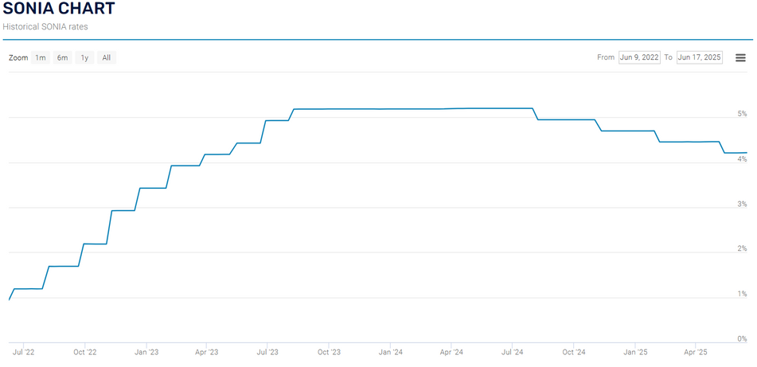
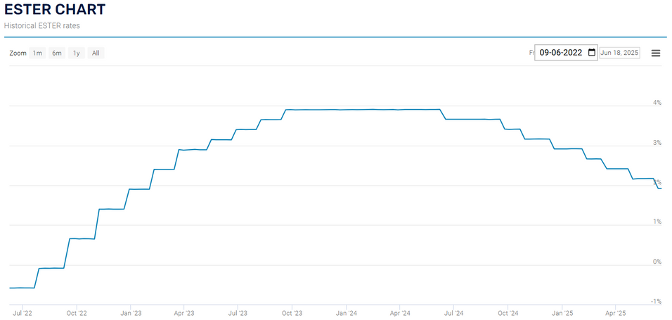
SONIA & ESTR - European RFRs
Sterling Overnight Index Average (SONIA)​
Euro Short-Term Rate (ESTR)​
Sterling Overnight Index Average (SONIA)​
Region: United Kingdom (GBP)​
Publisher: Bank of England​
Methodology: Unsecured, backward-looking, based on overnight deposits​
​
Region: Eurozone (EUR)​
Publisher: European Central Bank (ECB)​
Methodology: Unsecured, backward-looking, based on overnight lending​
Market Basis: Wholesale euro unsecured overnight borrowing​

Slide 7
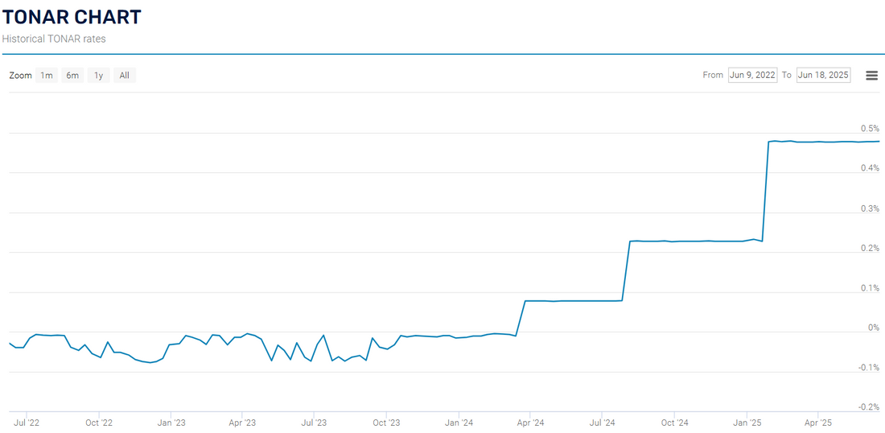
Tokyo Overnight Average Rate (TONAR)
Region: Japan (JPY)
Publisher: Bank of Japan
Methodology: Unsecured, backward-looking, call market based
Characteristics: Low volatility, reflects BoJ's ultra-accommodative policy
TONAR was negative to combat deflation and stimulate Japan's economy.
Positive: BOJ shifted to positive rates, confident in sustainable 2% inflation from wage growth.
Impact: Resulted in a stronger Yen, rising JGB yields, and boosted Japanese stocks (especially banks).

Slide 8
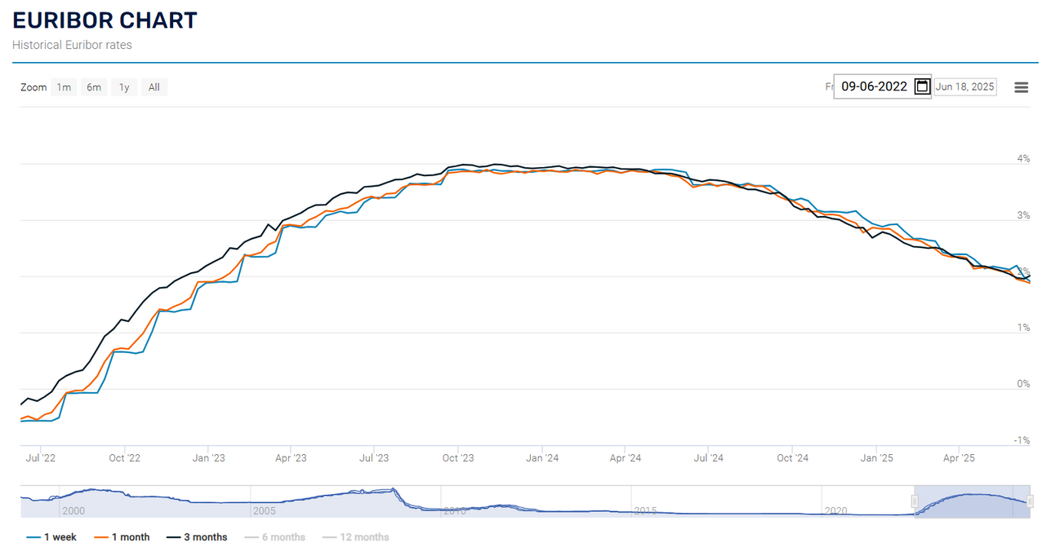
Euro Interbank Offered Rate
Definition: Rate at which eurozone banks lend to each other
Publisher: European Money Markets Institute (EMMI)
Methodology: Unsecured, forward-looking, hybrid (transaction + expert judgment)
Tenor Availability: 1 week, 1, 3, 6, 12 months
Why EURIBOR Survived
Successful reform program addressing regulatory concerns
Hybrid methodology combining transactions and expert judgment
Strong governance and oversight framework
Deep integration in European financial markets

Slide 9
Conclusion
1. Deep Market Liquidity
📊 $2.4 trillion in daily SOFR-linked repo transactions (2025)
→ Demonstrates robust adoption and strong investor confidence in secured funding markets.
2. Sustained Market Resilience
📉 VIX remained below 20 throughout 2023–2025 despite multi-decade high interest rates
→ Indicates markets adapted to “higher-for-longer” policy without widespread volatility or instability.
3. Enhanced Transparency & Credibility
✅ Over 90% of new derivatives and floating-rate issuances in USD and GBP now reference RFRs
→ Transition to transaction-based rates like SOFR and SONIA has improved benchmark integrity and reduced manipulation risk.
4. Credit Risk Explicitly Priced
💳 Credit spreads widened to ~1.4% on SOFR-based instruments
→ Replacing LIBOR’s embedded risk premium, lenders now apply add-ons based on borrower credit quality and collateral terms.
5. Regional Divergence Requires Localized Strategy
🌐 500+ basis point policy rate gap between SOFR (5.3%) and TONAR (0.1%) in 2025
→ Central bank policy divergence is increasing basis risk and driving demand for region-specific pricing and hedging strategies.

